Slide 1
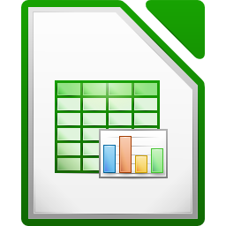


Spreadsheet
Class VI
lab 26

Slide 2
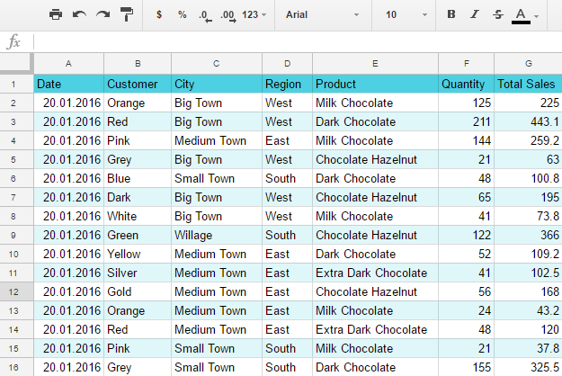
Demo Table

Slide 3
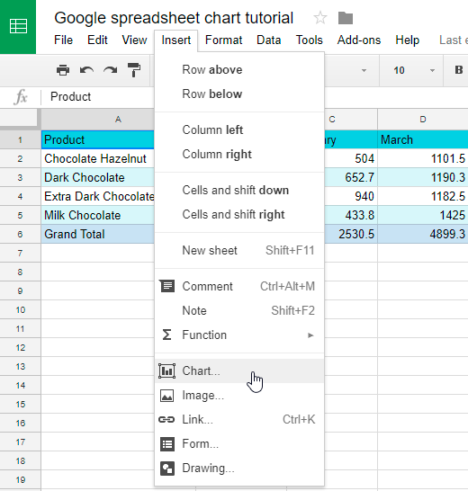
Making Chart
mark table and insert chart

Slide 4
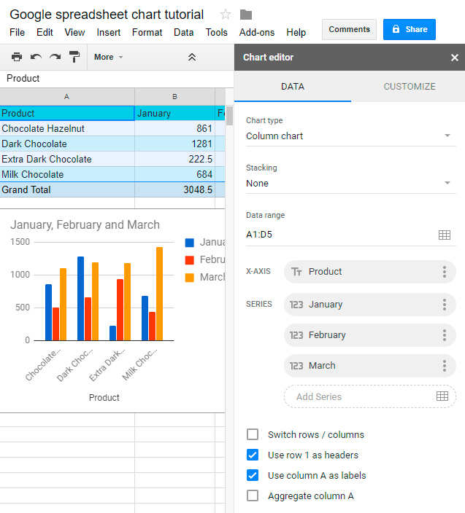
Making Chart
Analyze your data from chart

Slide 5
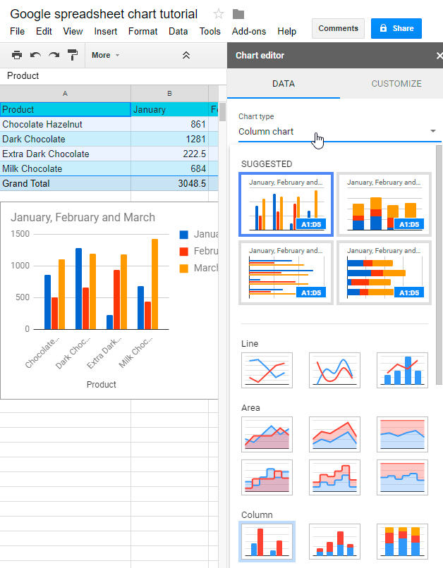
Making Chart
You can use different types of chart

Slide 6



